Slide 1
Z-TRANSFORM AND POLE-ZERO ANALYSIS
Matlab Program Report
Problem Statement
To write and execute a MATLAB program that defines the rational Z-transform X(z) = z² / [(z − 2)(z − 3)], displays the expression, calculates its zeros and poles symbolically, and draws the pole-zero map using the Control System Toolbox.
Objectives
  Initialize MATLAB and close existing figures.
  Define symbolic variables and the Z-transform expression.
  Extract the numerator and denominator and solve for zeros and poles.
  Plot and label the pole-zero map.
Theory and calculations
The expression can be written as X(z) = z² / (z² − 5z + 6).
Zeros are roots of the numerator: z² = 0, so there is a repeated zero at z = 0. Poles are roots of the denominator: (z −
2)(z − 3) = 0, so the poles are z = 2 and z = 3.
Expected results
Zeros: 0, 0 (double zero at the origin)
Poles: 2, 3
Software required: MATLAB with Symbolic Math Toolbox and Control System Toolbox.

Slide 2
CODE:
clc;
clear;
close all;
syms z n
Xz = z^2 / ((z-2)*(z-3));
disp('Z-Transform X(z) = ');
pretty(Xz);
[num, den] = numden(Xz);
zeros_z = solve(num == 0, z);
poles_z = solve(den == 0, z);
disp('Zeros are:');
disp(zeros_z);
disp('Poles are:');
disp(poles_z);
figure;
pzmap(tf([1 0 0], [1 -5 6], 1));
title('Pole-Zero Plot of X(z)');
grid on;

Slide 3



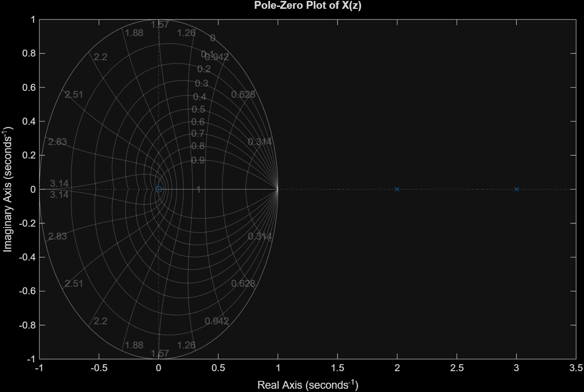
OUTPUT:
Z-Transform X(z) =
Zeros are:
Poles are:

Slide 4
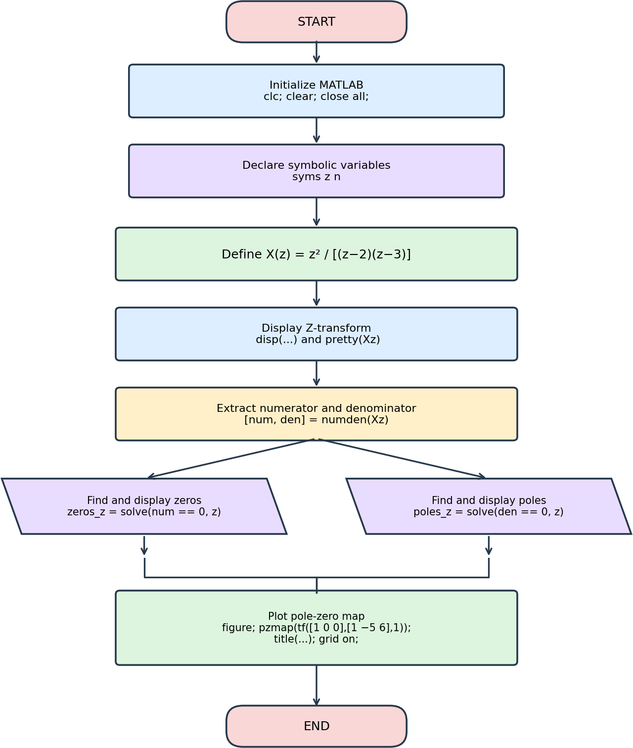
Flowchart
The flowchart represents the program sequence. The zero and pole calculations are performed in separate branches, then rejoin before the plotting step.

Slide 5
Applications
Pole-zero analysis is widely used in digital signal processing and discrete-time system analysis. The positions of poles and zeros help engineers understand system response and assess stability.
Real-world applications
  Digital filters: Pole-zero locations help design low-pass, high-pass, band-pass, and notch filters used for audio enhancement and noise removal.
  Communication systems: Engineers use pole-zero models when analyzing discrete-time channels, equalizers, and signal-shaping systems.
  Audio and speech processing: Rational Z-transform models support speech analysis, audio equalization, and resonance modeling.
  Digital control systems: Pole locations help evaluate stability and transient response in digital controllers and embedded systems.
  Biomedical signal processing: Digital filters can reduce unwanted noise or baseline drift in ECG and other sensor measurements.
Interpretation of this example
The expression has a repeated zero at z = 0 and poles at z = 2 and z = 3. Both poles are outside the unit circle. For a causal discrete-time system, poles outside the unit circle indicate instability. A complete stability conclusion also depends on the region of convergence (ROC), which is not specified in this code.
Conclusion
The MATLAB program calculates the zeros and poles of the given Z-transform and displays their locations in a pole-zero plot. This provides a visual way to understand system characteristics and is useful in filter design, communication, biomedical processing, and digital control.

